Slide 1
MEDICAL TEXTILES
By MAF Clothing PVT. LTD.

Slide 2
MEDICAL TEXTILES
MAF clothing Pvt Ltd , started its operation in 2009 by young and dynamic promoters with rich experience in the international market and is a full service group, based in India, built on a platform that strives to achieve a synergy that cannot be compared to the rest , thus allowing us to provide quality apparels / products worldwide. Strategically located in Bangalore and Tirupur (South India) MAF’s real strength lies in its production and product development, with the company's
management laying emphasis on QUALITY and PRODUCTIVITY. The company also has highly skilled associates and trained personnel ensuring QUALITY at every level.
MAF has 7000 employees working directly on its rolls UK design office
State of the Art factories for mask making with Centralised AC / PU Flooring / Disinfecting chamber Product sterilised with UV rays
MAF will start manufacturing its own Melt blown by Mid July in the same plant. The installed capacity will be ninety tons a month of the highest quality melt blown.
MAF plans to have Self sustainable solar energy for all its plants during the next twelve months. Presently one plant has solar energy generation.

Slide 3
MEDICAL TEXTILES
A bit more about what we do...
Some brief points about MAF’s facilities and current capacity
Product category apparel - Men’s / Women’s & Kids wear
Have a total of 3 woven’s factories with a total of 3500 machines and 6 knit factories with a total of 2500 machines Total capacity per month for knits - 1 million pcs
Total capacity per month for wovens - 1 million pcs
Total capacity per month for Lingerie - 80,000 pcs Bras and 200k panties
Home furnishing division currently processing Cushion covers / Table runners / Bedsheets / Curtains / Tea towels etc.
Washing plant in-house to cater to softener wash and other washes and overdyeing sourced out with all approved facilities
Label printing pad machine is inhouse Embroidery in house
Have majority of social audits approved like - GOTS / OEKOTEX / WRAP and SEDEX / OCS / ICS and CT-PAT We are also FAMA approved for licensed products
Amidst COVID-19 company has ventured into PPE suit and supplying to GOVT of India
SITRA / GMP /ISO 13485-2016 / FDA / CE compliance - Certification for Medical products - these can be shown on request

Slide 4
MEDICAL TEXTILES
Anti-Viral Defenses
Why are they relevant now?
With COVID-19 pandemic, global interest in masks and protective clothing has rocketed, and post-virus, consumer fears about further outbreaks will fuel a demand for material innovations that can safeguard health.
Application:
High-grade anti-viral materials and finishes are set to extend beyond medical-wear into mainstream apparel, as health fears drive these innovations into workwear and, ultimately, apparel and accessories.

Slide 5
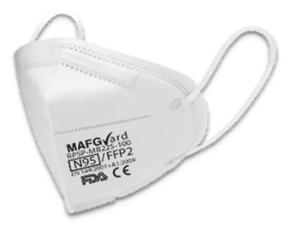
Protective Masks
MAF Medical Textles oﬀers a range of disposable p ro t e c t i v e masks including Non-woven 3 ply and N95 op�ons.
In-house 3 ply and N95 mask production machines. Capable of producing globally certified masks

Slide 6
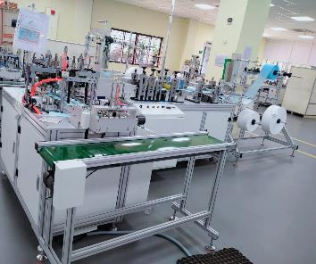
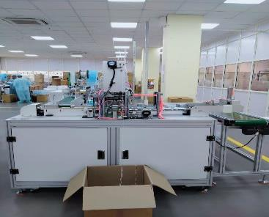
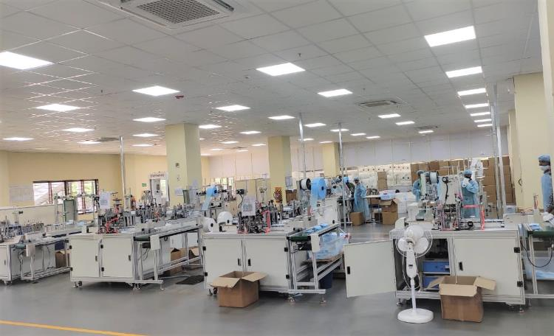

Slide 7
MEDICAL TEXTILES
Protective Masks
3 ply Surgical mask
3 ply mask - type 11R level 3 t e s ti ng with test reports pure melt blown ﬁlter
Color: Blue / Green
3 Ply nonwoven material
Soft elastic ear loop for easy ﬁt
Latex-free construction
Low lint
Size 175mm x 95mm
Ear loop head strap 18cm
Universal Size
Pliable nose piece provides adjustment
Packaging (Box 50)

Slide 8
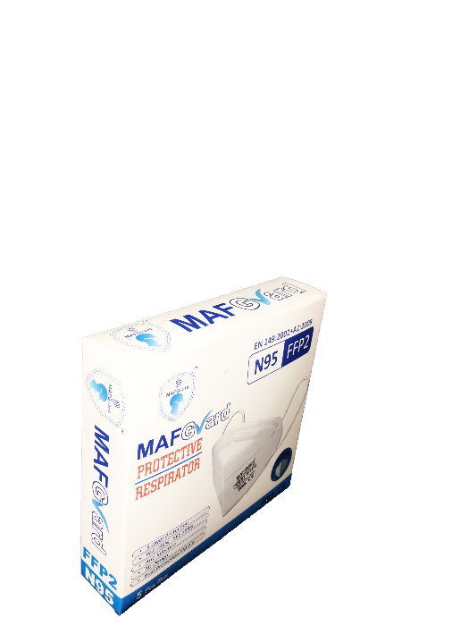
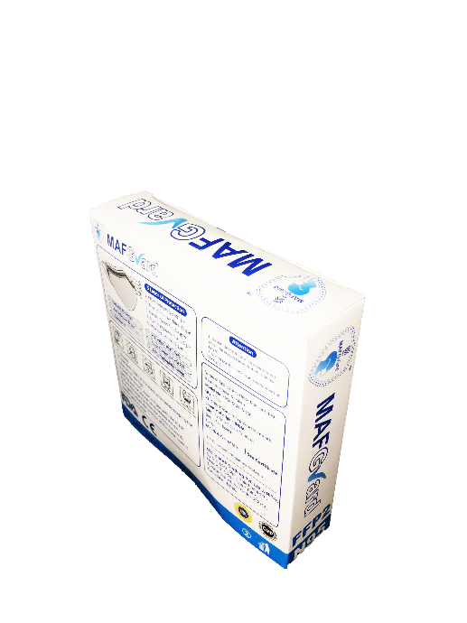
MEDICAL TEXTILES
Protective Masks
Protective respirator
[ without respirator ]
N95 mask type without the added valve
Colour: White
Features BFE > 98% & PFE > 95%
Five Layers of Material Include
• | 40 | GSM | Non W- oven
• | 25 | GSM | Melt - Blown Woven
• | 50 | GSM | Needle punch felt
• | 25 | GSM | Melt - Blown Woven
• | 25 | GSM | Non W- oven
Latex free Elastic, ear loop/ head on
Size 4.13 ” W x 6.299 ” H

Slide 9
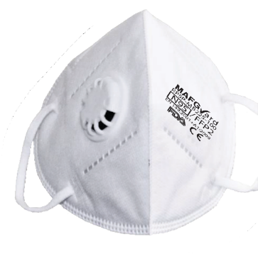
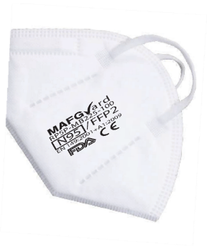
MEDICAL TEXTILES
Protective Masks
Protective respirator
[ with valve ]
N95 mask with added valve
Colour: White
Features BFE > 98% & PFE > 95%
Five Layers of Material Include
• | 40 | GSM | Non W- oven
• | 25 | GSM | Melt - Blown Woven
• | 50 | GSM | Needle punch felt
• | 25 | GSM | Melt - Blown Woven
• | 25 | GSM | Non W- oven
Latex free Elastic, ear loop/ head on
Size 4.13 ” W x 6.299 ” H

Slide 10
PPE Suit
MAF Medical Textiles oﬀers a range of disposable protective suits including a full protective PPE suit
Zipper fastens to underside of chin
3-piece hood
Fully elasticated waist
Ample crotch
Elastciated ankles

Slide 11
DISPOSABLE PROTECTIVE COVERALL
Protecting People

Slide 12
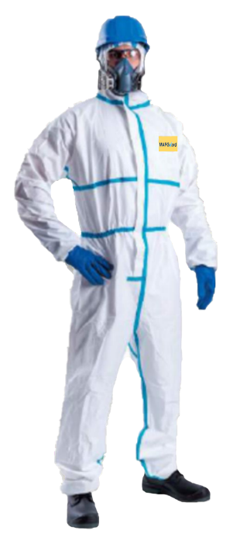
MAFGuard Body Protective Coverall
Type 4-B, 5-B, 6-B protective coverall against cytostatics, chemicals and biological agents
The type 4, 5, 6 hooded limited-life chemical protection suit, MAFGuard offers good protection when handling pathogenic agents and against many chemicals and biological agents. The well-known polyethylene film coated spunbonded is extremely comfortable to wear and meets the requirements of EN 1149-1 being anti-statically treated. Suitable for use as a pandemic protective gown.
Approved for AAMI PB70 Level 4, Test involved ASTM 1670, Resistance of Materials Used in Protective Clothing to Penetration by Synthetic Blood, ASTM 1671, Resistance of Materials Used in Protective Clothing to Penetration by Blood-Borne Pathogens Using Phi-X174 Bacteriophage Penetration.

Slide 13
MEDICAL TEXTILES
Ultrasonic seam welding process.
Specialised machine designed for sealing sewn seams for extra protection.

Slide 14
Style Guide
Key features like wrist, neck and back style can vary from own to gown. Use this style guide to understand the differences
WRIST STYLE OPTIONS
Hybrid elastic wrist
Elastic wrist Thumblock
Knit cuff
and thumblock
NECK STYLE OPTIONS
Tape tab Tie-neck Over-the-head hook and loop
BACK STYLE OPTIONS
Open-back* Full-back Overlapping back panels and side ties (full-back)
*This photo represents an example of an open-back gown, but does not represent the style of all open-back gowns.

Slide 15
ISOLATION GOWN LEVEL 1
Ensuring Care, Comfort & Compliance
Ensure you’re protected. Our protective apparel are tested and passed through stringent quality checks. We maintain highest quality standards to make sure you get right product. As a leader in protective apparel, we also provide wide range of comprehensive product line at low acquisition costs with no compromise on quality.

Slide 16
MEDICAL TEXTILES
Style
Model Number
Non Surgical Isolation Gown NS10 - SBPE000403 - OHKCFB
Non-surgical Isolation Gowns
Descripation
Full coverage, Light weight, low lint, ideal for protection against minimal levels of fluids.
Over the head neck, Full back, knit cuff, side tie on waist Non Woven, PPSB, PE laminate, 40 GSM
Knitted 1x1 rib, 97/3 poly/ elastane, 230 GSM, white 120 cm x 145 cm
Single Use Non Sterile stitching seam
Regular / Raglan
General Isolation in outpatient, inspection room at hospitals and clinics
OEA
AAMI PB70 Level 1 - AATCC - 42 Water Impact </= 4.5g Individual pcs in a sealed polybag
100 Pcs in a carton 53x41x42 cm
11.4 kgs.
2 yrs from the date of production
Design Fabric Cuﬀ Size Usage
Sterilisation
Seams Sleeve
Intended Use
Device L i s t i ng
T e s t n g standards Packaging
Carton Carton Size Gross wt Validity

Slide 17
MEDICAL TEXTILES
Style
Model Number
Non Surgical Isolation Gown NS10 - SBPE000403 - OHKCFB
Non-surgical Isolation Gowns
Description
Full coverage, Light weight, low lint, ideal for protection against minimal levels of fluids.
Over the head neck, Full back, knit cuff, side tie on waist Non Woven, PPSB, PE laminate, 40 GSM
Knitted 1x1 rib, 97/3 poly/ elastane, 230 GSM, white 120 cm x 145 cm
Single Use Non Sterile stitching seam
Regular / Raglan
General Isolation in outpatient, inspection room at hospitals and clinics
OEA
AAMI PB70 Level 1 - AATCC - 42 Water Impact </= 4.5g Individual pcs in a sealed polybag
100 Pcs in a carton 53x41x42 cm
11.4 kgs.
2 yrs from the date of production
Design Fabric Cuﬀ Size Usage
Sterilisation Seams Sleeve
Intended Use
Device Listing Te s t i n g standards Packaging
Carton Carton Size Gross wt Validity

Slide 19
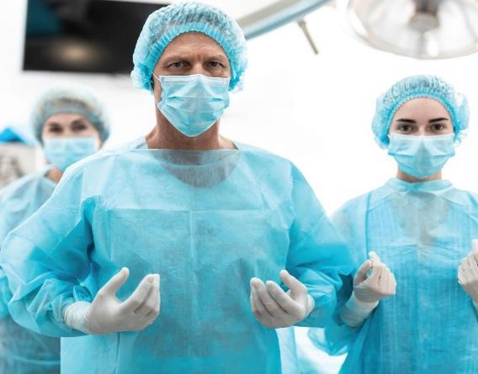
ISOLATION GOWN LEVEL 2
Ensuring Care, Comfort & Compliance
Ensure you’re protected. Our protective apparel are tested and passed through stringent quality checks. We maintain highest quality standards to make sure you get right product. As a leader in protective apparel, we also provide wide range of comprehensive product line at low acquisition costs with no compromise on quality.

Slide 20
MEDICAL TEXTILES
Style
Model Number
Non Surgical Isolation Gown NS20 - SMNL121401- HLKCOL
Non-surgical Isolation Gowns
Description
Full coverage, Medium weight, low lint, ideal for protection against low levels of fluids.
Hook & Loop neck tie, overlap back, knit cuff, tie on waist Non Woven, SMMS, PE laminate, 40 GSM
Knitted 1x1 rib, 97/3 poly/ elastane, 230 GSM, white 120 cm x 145 cm
Single Use Non Sterile
ULTRASONIC seam welding Regular / Raglan
General Isolation in outpatient, inspection room at hospitals and clinics
OEA
AAMI PB70 Level 2 - AATCC - 42 Water Impact </= 4.5g Individual pcs in a sealed polybag
100 Pcs in a carton 53x41x42 cm
11.4 kgs.
2 yrs from the date of production
Design Fabric Cuﬀ Size Usage
Sterilisat ion Seams Sleeve
Intended Use
Device Li s t i n g Te s t ng standards Packaging
Carton Carton Size Gross wt Validity

Slide 22
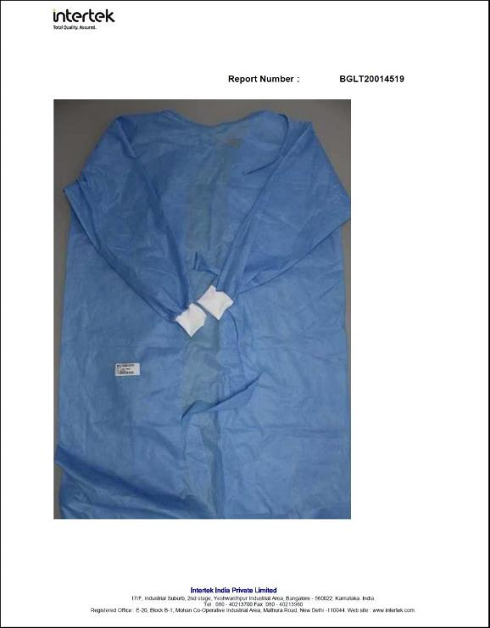
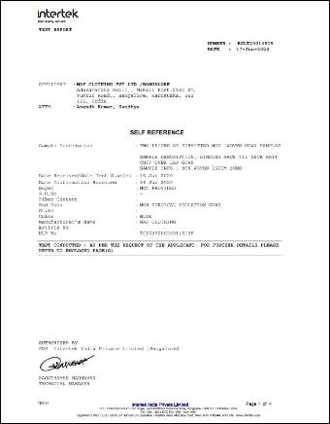

Slide 23
ISOLATION GOWN LEVEL 3
Ensuring Care, Comfort & Compliance
Ensure you’re protected. Our protective apparel are tested and passed through stringent quality checks. We maintain highest quality standards to make sure you get right product. As a leader in protective apparel, we also provide wide range of comprehensive product line at low acquisition costs with no compromise on quality.

Slide 24
MEDICAL TEXTILES
What does it take to become a Level 3 surgical gown?
Protective apparel, including surgical gowns, are governed by a set of standards and test methods that all manufacturers must meet.
MAFGuard has established a classification system (levels 1-4) for protective apparel used in health care facilities, including surgical gowns, based on liquid barrier performance using standardised test methods. These test methods are recognised worldwide and MAF ensures that each of it’s products are carefully tested using these specific tests.
Protection Levels
least protective
most protective
Within that standards, MAF carries out “Water resistance” tests to ensure the correct level of protection for each level of gown.
Water resistance Test 1
This test is called the “Water resistance: Impact Penetration Test”. It Indicates how the fabric will resist strikethrough when fluids splash or spray onto the fabric.
Water resistance Test 2
This test is called the “Water resistance: Hydrostatic Pressure Test”. It indictes how fabric will resist strikethrough when water pressure is applied to the surface of the fabric.
Testing the gown
Standards call for a surgical gown to meet the requirements mentioned above in the critical zones in order to be labeled a Level 3 surgical gown.
Cri�cal zones that must pass:
Front chest Sleeve seam Sleeve
Front belt* attachment point
What areas are included in the critical zones?
There are typically 4 different areas that must pass within the critical zones, including two in the front chest and two on the sleeves. If a product passes Tests 1 and 2 in all applicable areas, then it qualifies as a Level 3 Surgical gown.

Slide 25
MEDICAL TEXTILES
Style
Model Number D e s c ription
Performance Non Surgical Isolation Gown NS30--SBPE000501-H- LKCOL
Full coverage, Light weight, low lint, ideal for protection against moderate levels of fluids.
Adjustable hook & loop neck fasteners, Overlap back, knit cuff, double tie on waist
Non Woven, PPSB, PE coating, 50 GSM
Knitted 1x1 rib, 97/3 poly/ elastane, 230 GSM, white 120 cm x 145 cm
Single Use Non Sterile
Ultrasonic seam welding Regular / Raglan
Arterial blood draw, Inserting an IV, Emergency Room, Trauma OEA
AAMI PB70 Level 1 - AATCC - 42 Water Impact</= 1.0g AATCC-127 Hydrostatic pressure > 50 cm
Individual pcs in a sealed polybag 80 Pcs in a carton
53x41x55 cm
12.4 kgs.
3 yrs from the date of production
Performance Non-surgical Isolation Gowns
Design
Fabric Cuﬀ Size Usage
S terilisation Seams Sleeve
Intended Use Device Listing Te s t i n g standards
Packaging Carton Carton Size Gross wt Validity

Slide 26
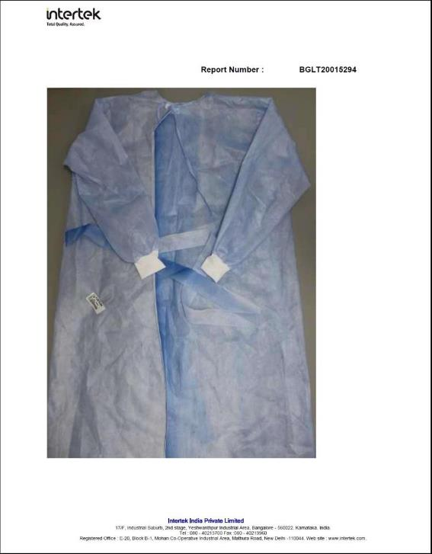
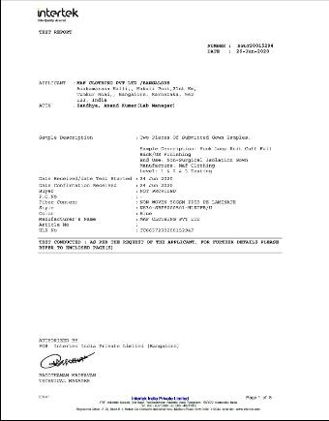

Slide 27
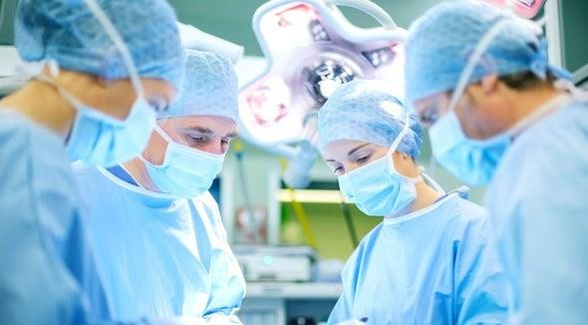
ISOLATION GOWN LEVEL 4
Ensuring Care, Comfort & Compliance

Slide 28
MEDICAL TEXTILES
Style
Model Number Description
Impervious Non Surgical Isolation Gown NS40-SBPE000700-H- LKCOL
Full coverage, Light weight, low lint, ideal for protection against High levels of fluids
Adjustable hook & loop neck fasteners, Overlap back, knit cuff, double tie on waist
Non Woven, PPSB, PE coating, 70 GSM
Knitted 1x1 rib, 97/3 poly/ elastane, 230 GSM, whit 120 cm x 145 cm
Single Use Non Sterile
Ultrasonic seam welding Regular / Raglan
Pathogen resistance, Infectious diseases (non-airborne), Large amounts of fluid exposure over long periods
OEA
AAMI PB70 Level 4
Impervious Non-surgical Isolation Gowns
Design
Fabric Cuﬀ Size Usage
Sterilisation Seams Sleeve
Intended Use
Device Li s t i ng Te s t i ng standards
Packaging Carton Carton Size Gross wt Validity
Individual pcs in a sealed polybag
60 Pcs in a carton 53x41x42 cm
13.9 kgs.
3 yrs from the date of production

Slide 29
MEDICAL TEXTILES
Gowns for out patients and visitors to hospitals.

Slide 30
Gowns for restaurants.
MEDICAL TEXTILES
MAF MT has developed gowns and coveralls for the growing demand of PPE in the restaurant and service industry. Our products offer a high level of protection that will meet the needs of any business requiring protection from cross-contamination.

Slide 31
MEDICAL TEXTILES
Disposable bedsheets, pillow cover and curtains

Slide 32
MEDICAL TEXTILES
Disposable seat covers
With people still reliant on public transport, MAF MT recognises the need for protection against contanimation in unavoidable close proximity areas. MAFGuard seat covers are the perfect solution to protecting an individual on public transport such as planes, trains and road vehicles.
2 styles of seat cover, svaialble in multiple colours.

Slide 33
MEDICAL TEXTILES
By MAF Clothing PVT. LTD.
Thank you

